Slide 1
AZ-400.00 Learning Path 04: Design and implement a release strategy

Slide 2
Learning Path overview

Slide 3
Learning Path overview
Module 01: Introduction to continuous delivery
Module 05: Manage and modularize tasks and templates
Module 02: Create a release pipeline
Module 06: Multi-stage YAML
Module 03: Explore release strategy recommendations
Module 07: Automate inspection of health
Module 04: Provision and test environments
Labs & Learning Path review and takeaways

Slide 4
Learning objectives
After completing this Learning Path, students will be able to:
Explain the terminology used in Azure DevOps and other release management tooling
Use release variables and stage variables in your release pipeline
Describe what a build and release task is, what it can do, and some available deployment tasks
Deploy to environment securely using a service connection
Explain why you sometimes need multiple release jobs in one release pipeline
List the different ways to inspect the health of your pipeline and release by using alerts, service hooks, and reports
Differentiate between a release and a deployment
Explain things to consider when designing your release strategy
Define the components of a release pipeline

Slide 5
Module 01: Introduction to continuous delivery

Slide 6
Explore traditional IT development cycle
A fair number of hotfixes and change requests for production
Many scope changes during a project
Lots of unplanned work due to technical debt (environment drift, poor quality, handoffs)
Business involved but not attached to IT

Slide 7
What is continuous delivery?
The eight principles of continuous delivery:
The process for releasing/deploying software MUST be repeatable and reliable
Done means “released”
Keep everything in source control
Improve continuously
Everybody has responsibility for the release process
If something is difficult or painful, do it more often
Automate everything!
Build quality in!

Slide 8
Move to continuous delivery

Slide 9
Understand releases and deployments
Release and deployment are often coupled
Release is not the same as a deployment
Separate functional release from technical release:
Functional release is exposing features to customers
Technical release is deploying functionality

Slide 10
Understand release process versus release
The release process involves all the steps that you go through when you move your artifact that comes from one of the artifact sources.
A release is a package or container that holds a versioned set of artifacts specified in a release pipeline in your CI/CD process. It holds all the information required to carry out all the tasks and actions in the release pipeline, such as the stages (or environments), the tasks for each one, values of task parameters and variables, the release policies such as triggers, approvers, and release queuing options.
There can be multiple releases from one release pipeline (or release process)

Slide 11
Discussion – the need for continuous delivery in your organization
Does your organization need continuous delivery?
Do you use agile/scrum?
Is everybody involved or only the Dev departments?
Can you deploy your application multiple times per day? Why or why not?
What is the main bottleneck for continuous delivery in your organization?
The Organization
Application Architecture
Skills
Tooling
Tests
Other things?

Slide 12
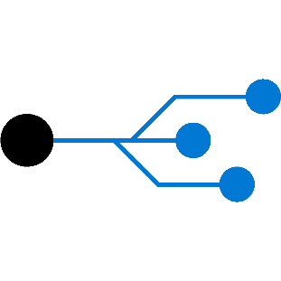
Module 02: Create a release pipeline

Slide 13
Describe Azure DevOps release pipeline capabilities
Support pipelines as code (via YAML)
Most capabilities from classic release pipelines are available

Slide 14
Explore release pipelines

Slide 15
Explore artifact sources
Build artifacts
Package repositories
Container repositories
Source control

Slide 16
Choose the appropriate artifact source
Traceability and auditability
Immutability
Versioning

Slide 17
Demonstration: selecting an artifact source
DEMO

Slide 18
Examine considerations for deployment to stages
Do we want/need to deploy every day?
What is your target environment?
Is it used by one team or is it used by multiple teams?
Who are the users? Do they want a new version multiple times a day?
How long does it take to deploy?
Is there downtime? What happens to performance? Are users impacted?

Slide 19
Deployment stages
What is a stage?
Different terms used in various release tools (stages/environment)
A logical boundary in a pipeline that contains one or more jobs
What is your target environment?
Long-lived or short-lived environments
Purpose of an environment
Feature release and bugfix

Slide 20
Setting up deployment stages
DEMO

Slide 21
Explore build and release tasks
Units of executable code used to perform designated actions in a specified order
Tasks building, testing, running utilities, packaging, and deploying
Extensible model
Community tasks available in marketplace

Slide 22
Explore custom build and release tasks
Private or public accessible
Access to variables that are otherwise not accessible
Use and reuse secure endpoint to a target server
Safely and efficiently distribute across your whole organization
Users do not see implementation details

Slide 23
Explore release jobs
A job is a series of tasks that run sequentially on the same target
Can be combined in one pipeline to enable multi-platform deployment:
E.g., deploy .NET backend via Windows, iOS app via MacOS and Angular frontend via Linux
Jobs run on the host machine where the agent is installed

Slide 24
Discussion: How to use release jobs
Do you see a purpose for release jobs in your pipeline? How would you set it up?
Topics you might want to consider are:
Do you have artifacts from multiple sources?
How long does your release take?
Can you run your deployment in parallel or does it need to run in sequence?
Do you want to run deployments on different servers simultaneously?
Do you need multiple platforms?

Slide 25
Module 03: Explore release strategy recommendations

Slide 26
Understand the delivery cadence and three types of triggers
Continuous deployment trigger
Scheduled trigger
Manual trigger

Slide 27
Selecting your delivery and deployment cadence
DEMO
Notes:
You can choose to play the video or present a similar demo yourself.

Slide 28
Explore release approvals
Release approvals are not to control how, but control if you want to deliver multiple times a day
Manual Approvals help in building trust about the automated release process
Release gates give you additional control over the start and completion of the deployment pipeline. They can usually be set up as a pre-deployment and post-deployment condition and can perform validation with other automated systems until specific requirements are verified.

Slide 29
Demonstration: setting up manual approvals
DEMO
Notes:
You can choose to play the video or present a similar demo yourself.

Slide 30
Explore release gates
Release gates give you additional control over the start and completion of the deployment pipeline. They are often set up as a pre-deployment and post-deployment conditions.
Incident and issues management
User experience relative to baseline
Notification of users by integration with collaboration systems
Change management
Quality validation
Infrastructure health
Security scan on artifacts

Slide 31
Use release gates to protect quality
No new blocker issues
Compliance checks
Code coverage on new code greater than 80%
Are there work items linked to the release?
Is the release started by someone else as the code committer?
No license violations
Is the performance not affected after a new release?
No vulnerabilities in dependencies
No new technical debt introduced

Slide 32
Setting up a release gate
DEMO
Notes:
You can choose to play the video or present a similar demo yourself.

Slide 33
Module 04: Provision and test environments

Slide 34
Provision and configure target environments
On-premises servers
Cloud servers or Infrastructure as a Service (IaaS). For example, virtual machines or networks
Platform as a Service (PaaS) and Functions as a Service (FaaS). For example, Azure SQL Database in both PaaS and Serverless options
Clusters
Service connections

Slide 35
Demonstration: Set up service connections
DEMO
Notes:
Take a moment to complete the demonstration, as defined in the student manual.

Slide 36
Configure automated integration and functional test automation
Do not automate all your manual tests
Rethink test strategy
Tests should be written at the lowest level possible
Write once, run anywhere including production system
Product is designed for testability
Test code is product code, only reliable tests survive
Test ownership follows product ownership
Source: https://lisacrispin.com/2011/11/08/using-the-agile-testing-quadrants/

Slide 37
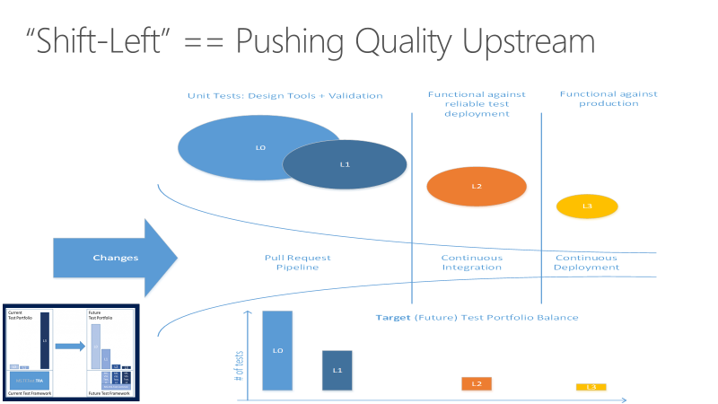
Understand Shift-left
The goal for shifting left is to move quality upstream by performing tests early in the pipeline.
Combine test and process improvements to reduce the time it takes for tests.
Notes:
Discuss about shift-left:
https://docs.microsoft.com/en-us/devops/develop/shift-left-make-testing-fast-reliable
Suggestion: Talk about the case study in shifting left at a team at Microsoft.

Slide 38
Set up and run availability tests
Create health end points in your application
Use tools, e.g., availability tests in Application Insights, to test health endpoints
Two common types of availability tests:
URL ping test
Multi-step web test

Slide 39
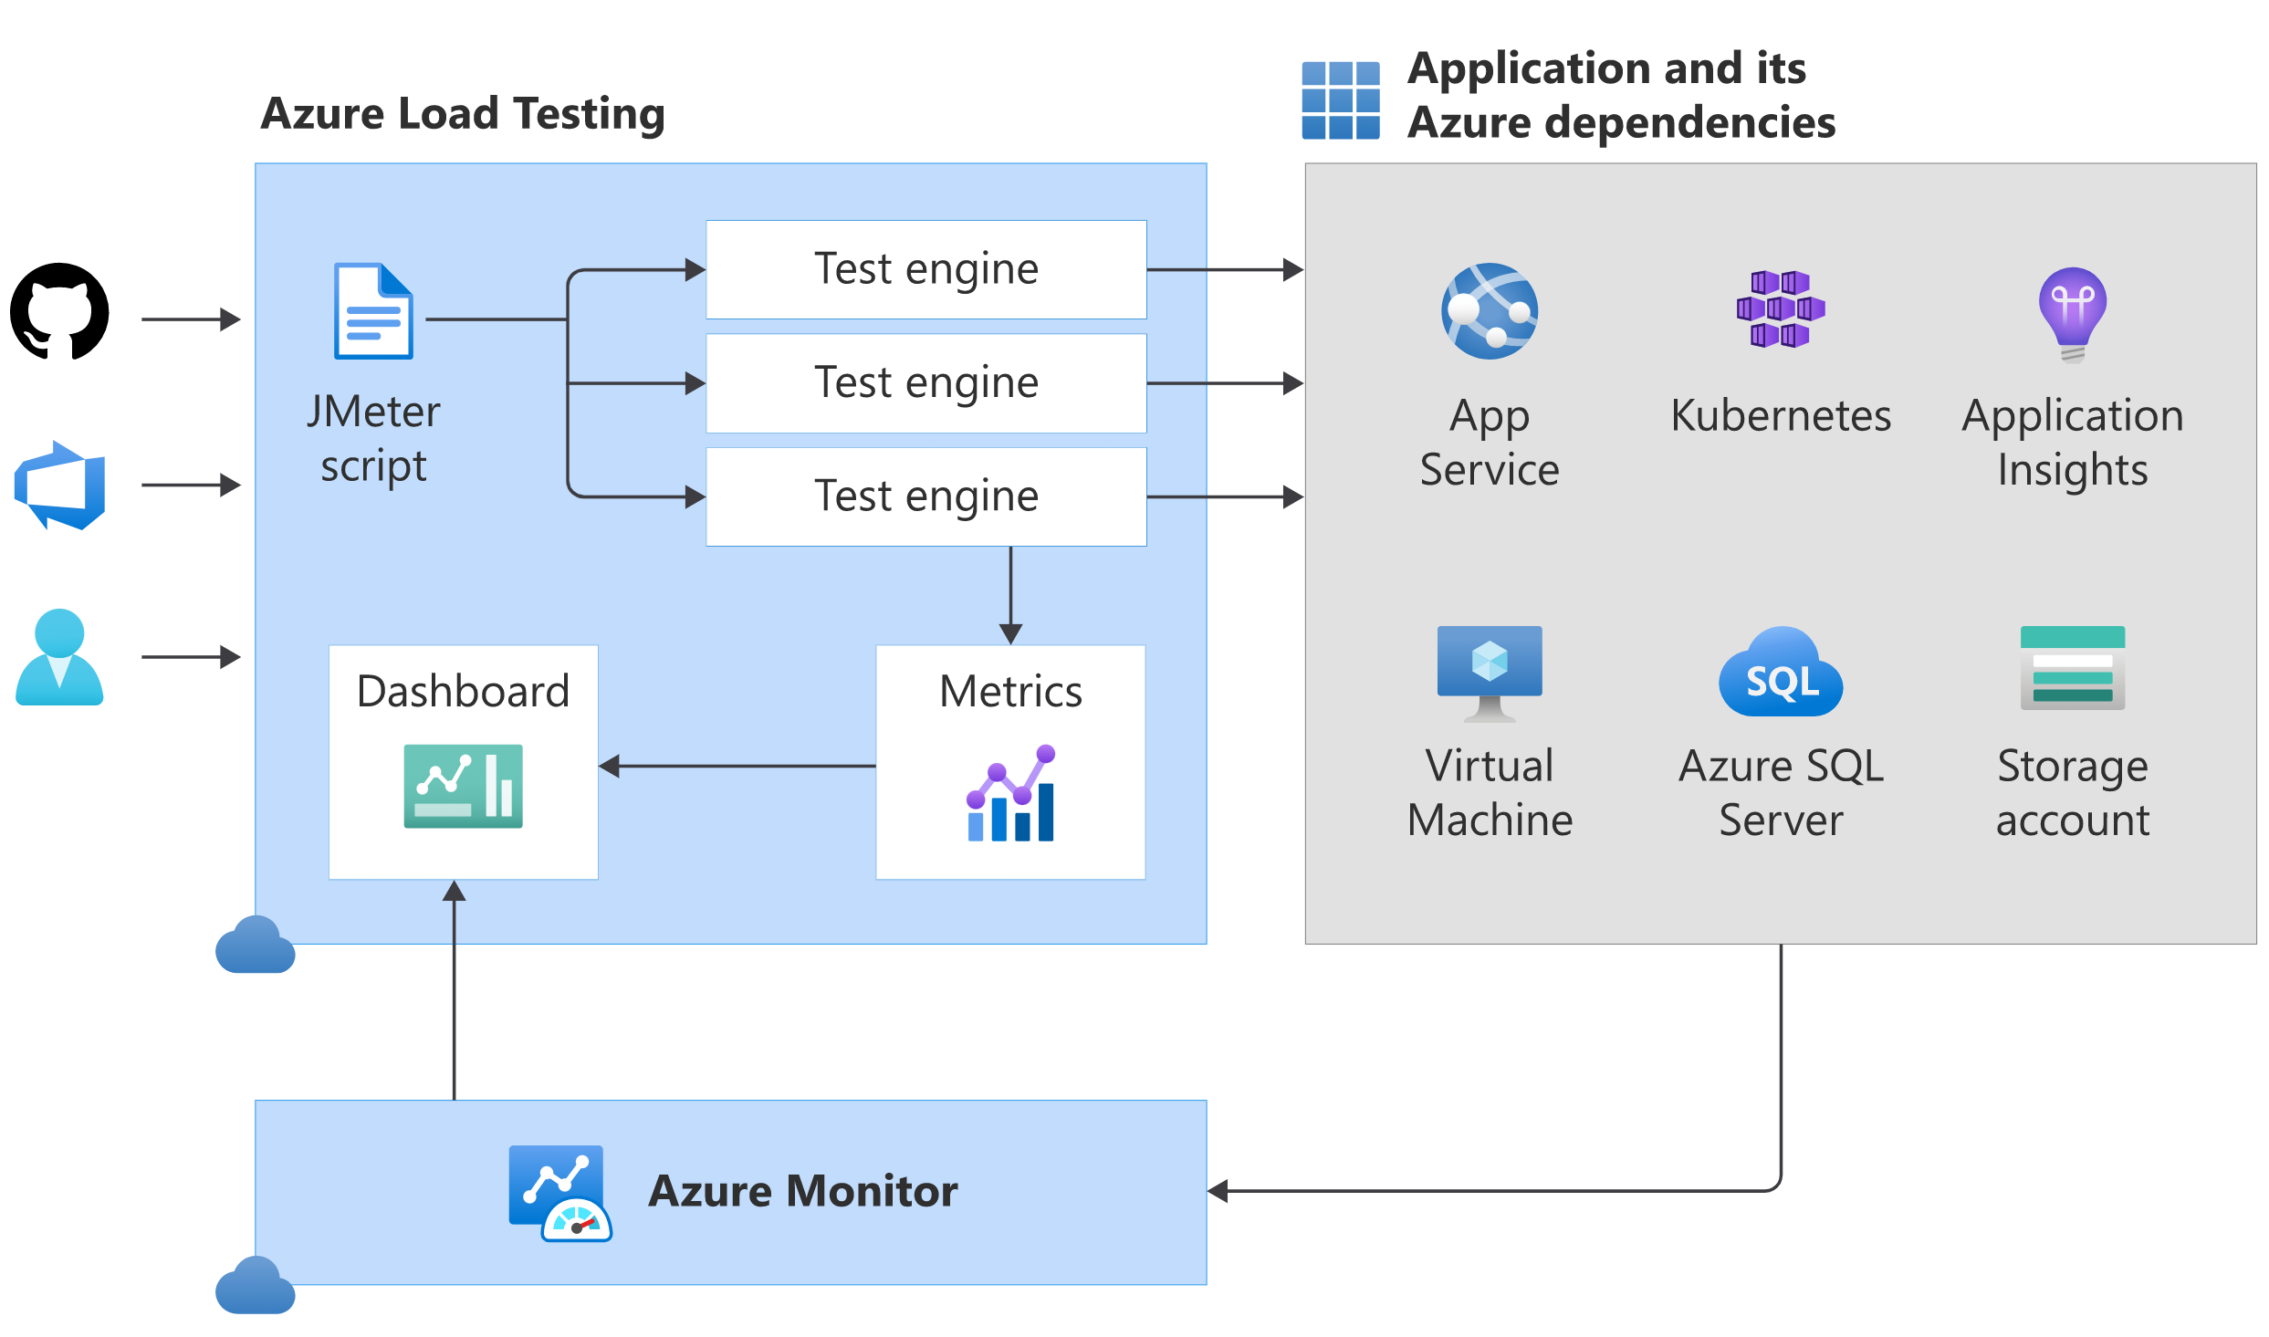
Explore Azure Load Testing
Azure Load Testing Preview is a fully managed load-testing service that enables you to generate high-scale load.
Integrate Azure Load Testing in your CI/CD pipeline during the development lifecycle.
Notes:
Explain Azure Load Testing: https://docs.microsoft.com/en-us/azure/load-testing/overview-what-is-azure-load-testing
Azure Load Testing Preview is a fully managed load-testing service that enables you to generate high-scale load.
The service simulates traffic for your applications, helping you to optimize application performance, scalability, or capacity.
You can create a load test using existing test scripts based on Apache JMeter. Azure Load Testing abstracts the infrastructure to run your JMeter script and load test your application.
For Azure-based applications, Azure Load Testing collects detailed resource metrics to help you identify performance bottlenecks (https://docs.microsoft.com/en-us/azure/load-testing/tutorial-identify-bottlenecks-azure-portal) across your Azure application components.
You can automate regression testing (https://docs.microsoft.com/en-us/azure/load-testing/overview-what-is-azure-load-testing#enable-automated-load-testing) by running load tests as part of your continuous integration and continuous deployment (CI/CD) workflow.
You can automatically run a load test at the end of each sprint or in a staging environment to validate a release candidate build.
You can trigger Azure Load Testing from Azure Pipelines or GitHub Actions workflows.

Slide 40
(Optional) Demonstration: Identify performance regressions with Azure Load Testing Preview and GitHub Actions
DEMO
Notes:
Take a moment to complete the demonstration:
https://docs.microsoft.com/en-us/azure/load-testing/tutorial-cicd-azure-pipelines?wt.mc_id=loadtesting_acomresources_webpage_cnl

Slide 41
Module 05: Manage and modularize tasks and templates

Slide 42
Examine task groups
Encapsulate a sequence of tasks in one reusable task
Parameterization of task groups to make reuse easier
Standardize and centrally manage deployment steps for all your applications
Note: Task groups are not currently supported in YAML. Use templates instead.

Slide 43
Demonstration: Creating and managing task groups
DEMO
Notes:
Take a moment to complete the demonstration, as defined in the student manual.

Slide 44
Explore variables in release pipelines
Predefined Variables
Pipeline variables
Stage Variables
Variable groups
Normal and Secret variables

Slide 45
Understand variable groups
A variable group is used to store values that you want to make available across multiple builds and release pipelines:
Store the username and password for a shared server
Store a share connection string
Store the geolocation of an application
Store all settings for a specific application

Slide 46
Demonstration: Creating and managing variable groups
DEMO
Notes:
Take a moment to complete the demonstration, as defined in the student manual.

Slide 47
Module 06: Multi-stage YAML

Slide 48
Describe Deployment Jobs strategies
Enable initialization
Deploy the update
Route traffic to the updated version
Test the updated version after routing traffic
If there's a failure, run steps to restore to the last known good version.
Notes:
For details about Deployment Jobs Strategies, see https://docs.microsoft.com/azure/devops/pipelines/process/deployment-jobs?view=azure-devops#deployment-strategies.
Deployment strategies allow you to use specific techniques to deliver updates when deploying your application.
Techniques examples:
Enable initialization.
Deploy the update.
Route traffic to the updated version.
Test the updated version after routing traffic.
In case of failure, run steps to restore to the last known good version.
You can achieve this by using lifecycle hooks that run steps during the deployment.

Slide 49
Describe lifecycle hooks
preDeploy – Used to run steps that initialize resources before application deployment starts.
deploy – Used to run steps that deploy your application.
routeTraffic – Used to run steps that serve the traffic to the updated version.
postRouteTraffic – Used to run the steps after the traffic is routed.
on: failure or on: success – Used to run steps for rollback actions or clean-up.
Notes:
For details about Lifecycle hooks, seehttps://docs.microsoft.com/azure/devops/pipelines/process/deployment-jobs?view=azure-devops#deployment-strategies.
preDeploy: Used to run steps that initialize resources before application deployment starts.
deploy: Used to run steps that deploy your application. Download artifact task will be auto injected only in the deploy hook for deployment jobs. To stop downloading artifacts, use - download: none or choose specific artifacts to download by specifying https://docs.microsoft.com/en-us/azure/devops/pipelines/tasks/utility/download-pipeline-artifact?view=azure-devops.
routeTraffic: Used to run steps that serve the traffic to the updated version.
postRouteTraffic: Used to run the steps after the traffic is routed. Typically, these tasks monitor the health of the updated version for defined interval.
on: failure or on: success: Used to run steps for rollback actions or clean-up.

Slide 50
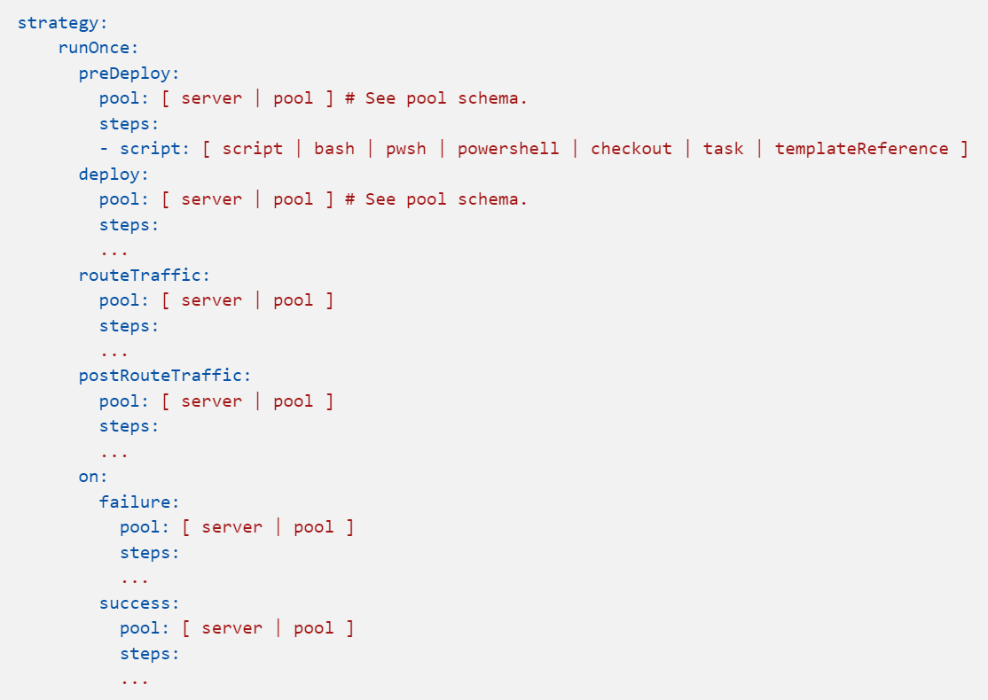
Describe Deployment Jobs strategies - RunOnce
runOnce is the simplest deployment strategy wherein all the lifecycle hooks are executed:
preDeploy
deploy
routeTraffic
postRouteTraffic
Then, either on: success or on: failure is executed.
Notes:
For details about Deployment Jobs Strategies, see https://docs.microsoft.com/azure/devops/pipelines/process/deployment-jobs?view=azure-devops#deployment-strategies.
runOnce is the simplest deployment strategy wherein all the lifecycle hooks, namely preDeploy deploy, routeTraffic, and postRouteTraffic, are executed once. Then, either on: success or on: failure is executed.
strategy:
runOnce:
preDeploy:
pool: [ server | pool ] # See pool schema.
steps:
- script: [ script | bash | pwsh | powershell | checkout | task | templateReference ]
deploy:
pool: [ server | pool ] # See pool schema.
steps:
...
routeTraffic:
pool: [ server | pool ]
steps:
...
postRouteTraffic:
pool: [ server | pool ]
steps:
...
on:
failure:
pool: [ server | pool ]
steps:
...
success:
pool: [ server | pool ]
steps:
...

Slide 51
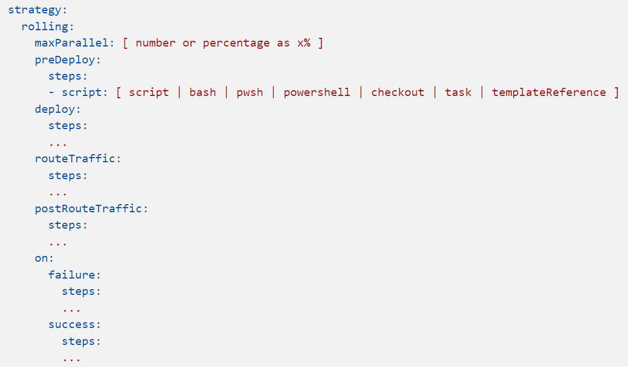
Describe Deployment Jobs strategies - Rolling
A rolling deployment replaces instances of the previous version of an application with instances of the new version.
It can be configured by specifying the keyword rolling: under the strategy: node.
Notes:
For details about Deployment Jobs Strategies, see https://docs.microsoft.com/azure/devops/pipelines/process/deployment-jobs?view=azure-devops#deployment-strategies.
A rolling deployment replaces instances of the previous version of an application with instances of the new version. It can be configured by specifying the keyword rolling: under the strategy: node.
strategy:
rolling:
maxParallel: [ number or percentage as x% ]
preDeploy:
steps:
- script: [ script | bash | pwsh | powershell | checkout | task | templateReference ]
deploy:
steps:
...
routeTraffic:
steps:
...
postRouteTraffic:
steps:
...
on:
failure:
steps:
...
success:
steps:
...

Slide 52
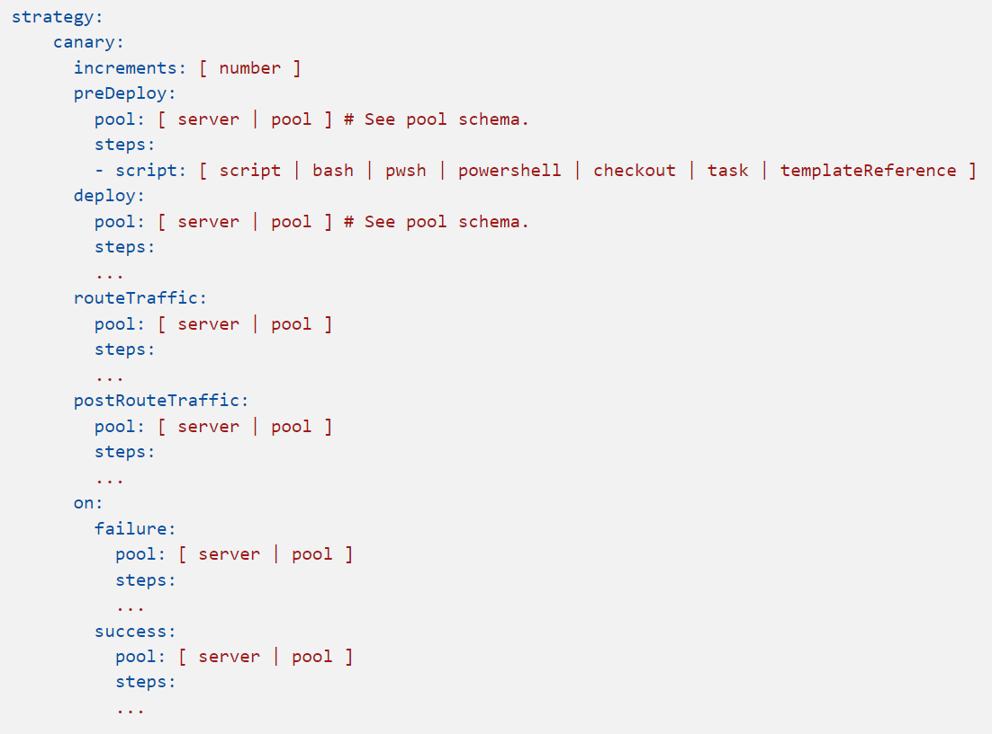
Describe Deployment Jobs strategies - Canary
Advanced deployment strategy that helps mitigate the risk involved in rolling out new versions of applications.
Roll out the changes to a small subset of servers first.
Release it to more servers in your infrastructure and route more traffic to it.
Notes:
For details about Deployment Jobs Strategies, seehttps://docs.microsoft.com/azure/devops/pipelines/process/deployment-jobs?view=azure-devops#deployment-strategies.
By using this strategy, you can roll out the changes to a small subset of servers first. The canary deployment strategy is an advanced deployment strategy that helps mitigate the risk involved in rolling out new versions of applications.
As you gain more confidence in the new version, you can release it to more servers in your infrastructure and route more traffic to it.
strategy:
canary:
increments: [ number ]
preDeploy:
pool: [ server | pool ] # See pool schema.
steps:
- script: [ script | bash | pwsh | powershell | checkout | task | templateReference ]
deploy:
pool: [ server | pool ] # See pool schema.
steps:
...
routeTraffic:
pool: [ server | pool ]
steps:
...
postRouteTraffic:
pool: [ server | pool ]
steps:
...
on:
failure:
pool: [ server | pool ]
steps:
...
success:
pool: [ server | pool ]
steps:
...

Slide 53
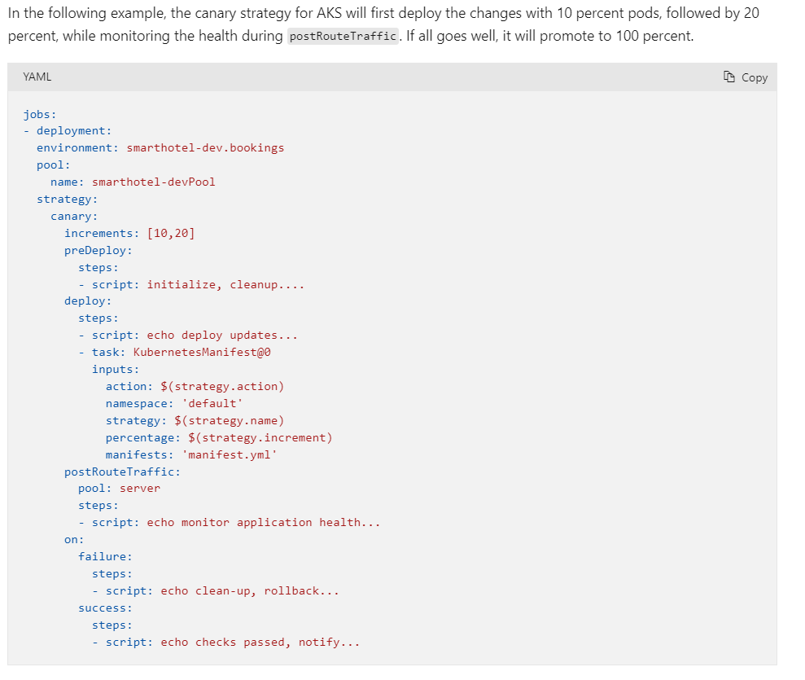
Describe Deployment Jobs strategies – Canary for AKS example
In the following example, the canary strategy for AKS will first deploy the changes with 10 percent pods, followed by 20 percent, while monitoring the health during postRouteTraffic. If all goes well, it will promote to 100 percent.
Notes:
Optional.

Slide 54

Module 07: Automate inspection of health

Slide 55
Automate inspection of health
Stay informed about your process and releases:
Release gates
Events, subscriptions, and notifications
Service hooks
Reporting

Slide 56
Explore events and notifications
Actions in Azure DevOps trigger events
Users can subscribe to events and get notified receiving an email
Notifications can be managed centrally and personally

Slide 57
Explore service hooks
Service hooks enable you to perform tasks on other services when events happen
Out of the box integrations
Build and release | Collaborate | Customer support | Plan and track | Integrate
AppVeyor | Campfire | UserVoice | Trello | Azure Service Bus
Bamboo | Flowdock | Zendesk |  | Azure Storage
Jenkins | HipChat |  |  | Web Hooks
MyGet | Hubot |  |  | Zapier
Slack

Slide 58
Demonstration: Set up service hooks to monitor the pipeline
DEMO
Notes:
Take a moment to complete the demonstration, as defined in the student manual.

Slide 59
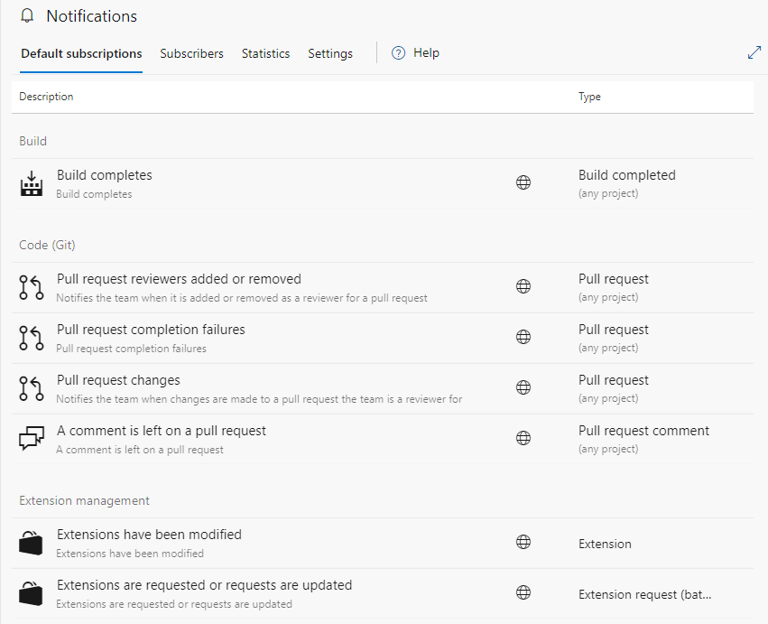
Configure Azure DevOps notifications
You can get notified when changes occur to the following items:
Work items.
Code reviews.
Pull requests.
Source control files (TFVC or Git).
Builds.
Release.
Subscriptions arise from the following instances:
Out-of-the-box (OOB) or default.
Created by an administrator for a team or group that you belong to.
Created by you.
Notes:
Details about notifications using Azure DevOps:
https://docs.microsoft.com/en-us/azure/devops/notifications/about-notifications?view=azure-devops
Explain details about Azure DevOps notifications and subscriptions and what is available.
You can configure notifications to be sent based on rules or subscriptions by default, out-of-the-box (OOB), created by you or the team or group administrator.
You can get a notification when the following items change:
Work items.
Code reviews.
Pull requests.
Source control files (TFVC or Git).
Builds.
Release.
For example, you can get notified whenever you or your team resolves a bug or are assigned a work item.
Notifications get sent based on set up rules or subscriptions. Subscriptions arise from the following instances:
Out-of-the-box (OOB) or default
Created by an administrator for a team or group that you belong to
Created by you

Slide 60
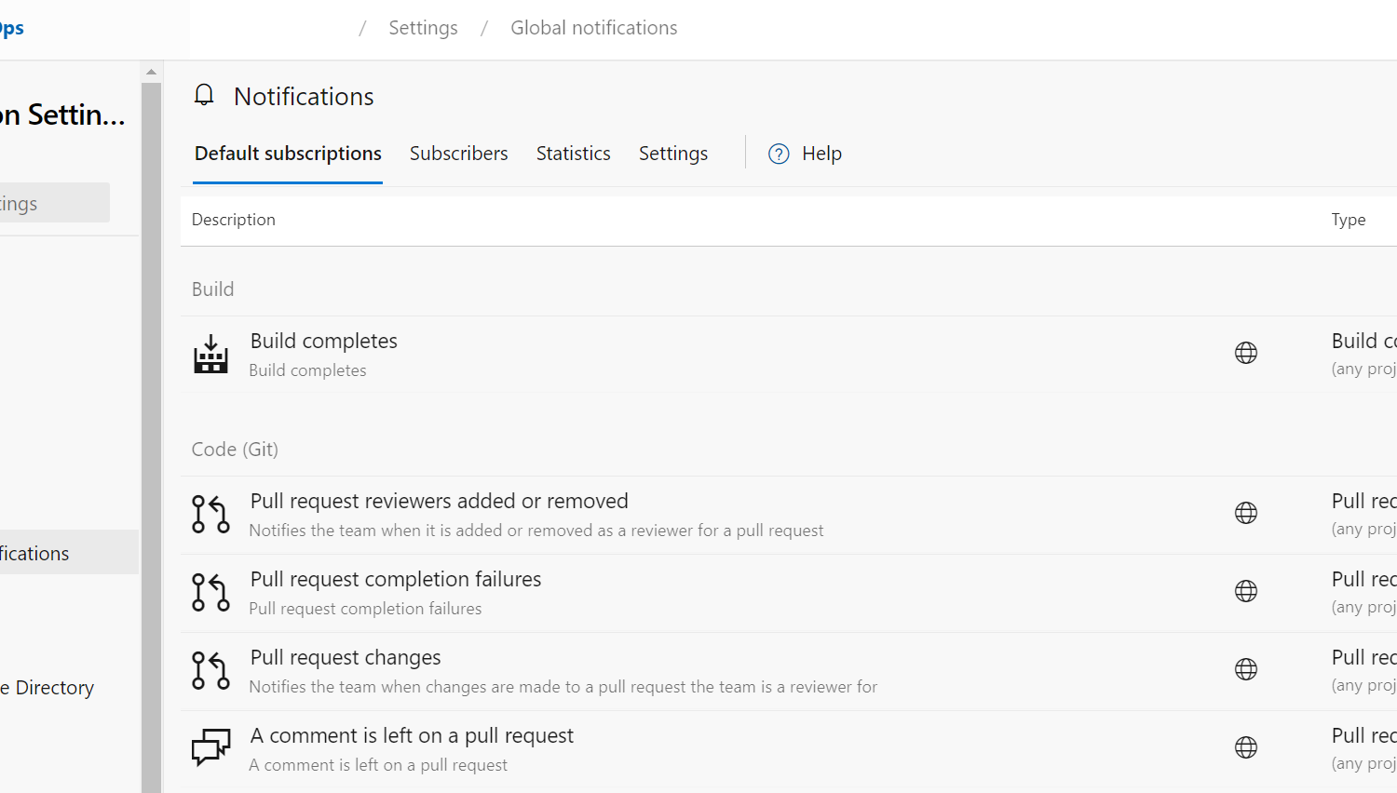
Demonstration: Configure Azure DevOps notifications
DEMO
Notes:
Take a moment to complete the demonstration:
https://docs.microsoft.com/en-us/azure/devops/notifications/about-notifications?view=azure-devops
For each notification, you have a set of specific steps to configure. The following steps show how to manage global notifications:
Open your Azure DevOps organization https://dev.azure.com/{organization}/_settings/organizationOverview.
Click on Organization settings at the bottom left side.
Click on Global notifications under the General tab.
Enable/disable and view notifications. Explain about subscription and benefits.

Slide 61
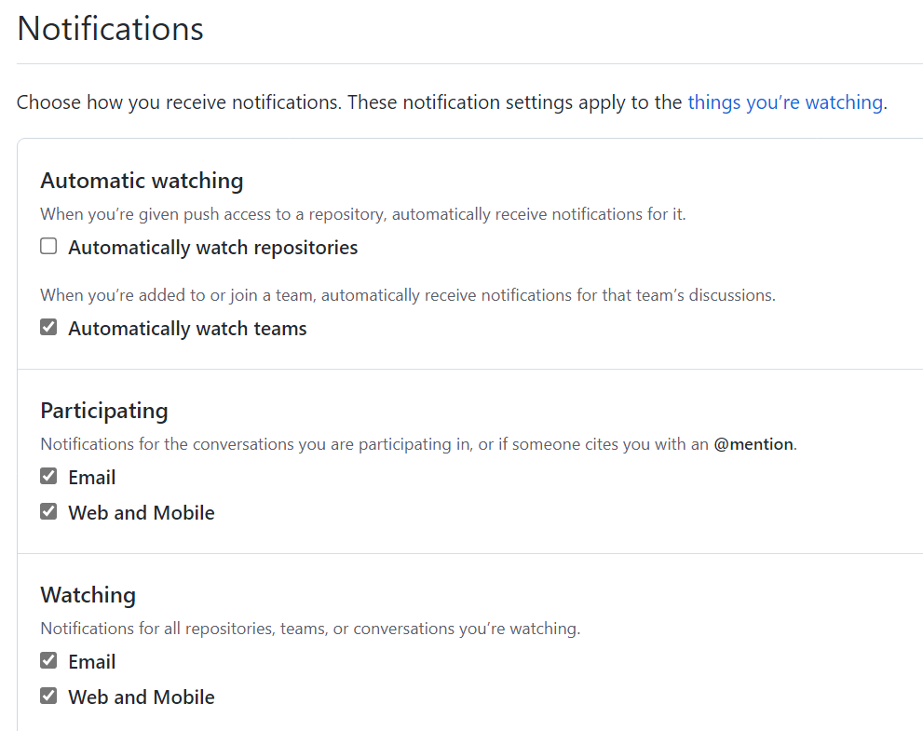
Configure GitHub notifications
By default, you automatically watch all repositories you create subscribe to conversations when you have:
Not disabled automatic watching for repositories or teams you've joined in your notification settings.
Been assigned to an issue or pull request.
Opened a pull request, issue, or created a team discussion post.
Commented on a thread.
Subscribed to a thread manually by clicking Watch or Subscribe.
Had your username @mentioned.
Changed the thread's state by closing an issue or merging a pull request.
Had a team you're a member of @mentioned.
Notes:
Details about notifications using GitHub.com:
https://docs.github.com/en/account-and-profile/managing-subscriptions-and-notifications-on-github/setting-up-notifications/configuring-notifications#github-actions-notification-options
Explain details about GitHub notifications and subscriptions and what is available.
Github.com notifications provide updates about the activity that you've subscribed to. You can use the notifications inbox to customize, triage, and manage your updates.
You can choose to subscribe to notifications for:
A conversation in a specific issue, pull request, or gist.
All activity in a repository or team discussion.
CI activity, such as the status of workflows in repositories set up with GitHub Actions.
Repository issues, pull requests, releases, security alerts, or discussions (if enabled).
By default, you automatically watch all repositories you create and own by your personal account and subscribe to conversations when you have:
Not disabled automatic watching for repositories or teams you've joined in your notification settings.
Been assigned to an issue or pull request.
Opened a pull request, issue, or created a team discussion post.
Commented on a thread.
Subscribed to a thread manually by clicking Watch or Subscribe.
Had your username @mentioned.
Changed the thread's state by closing an issue or merging a pull request.
Had a team you're a member of @mentioned.

Slide 62
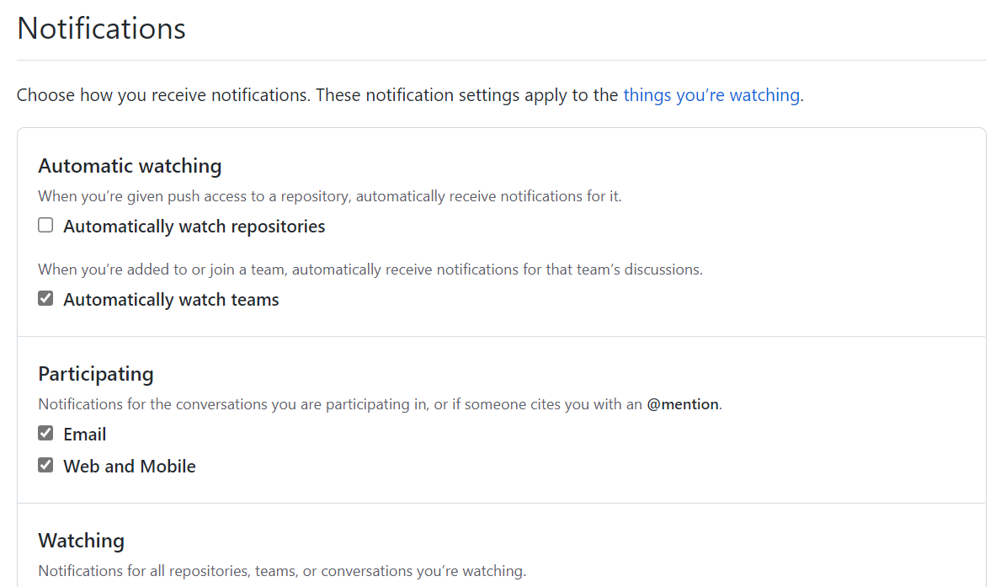
Demonstration: Configure GitHub notifications
DEMO
Notes:
Take a moment to complete the demonstration by going through the notification settings:
https://docs.github.com/en/account-and-profile/managing-subscriptions-and-notifications-on-github/setting-up-notifications/configuring-notifications#github-actions-notification-options
Notification settings
Click on the notification icon in the upper-right corner of any page.
Click on the notification settings under the list of repositories in the left sidebar.
On the notifications settings page, choose how you receive notifications.

Slide 63
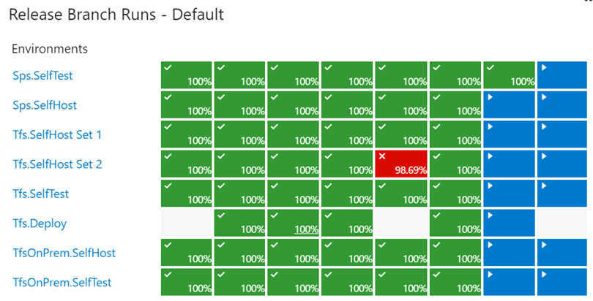
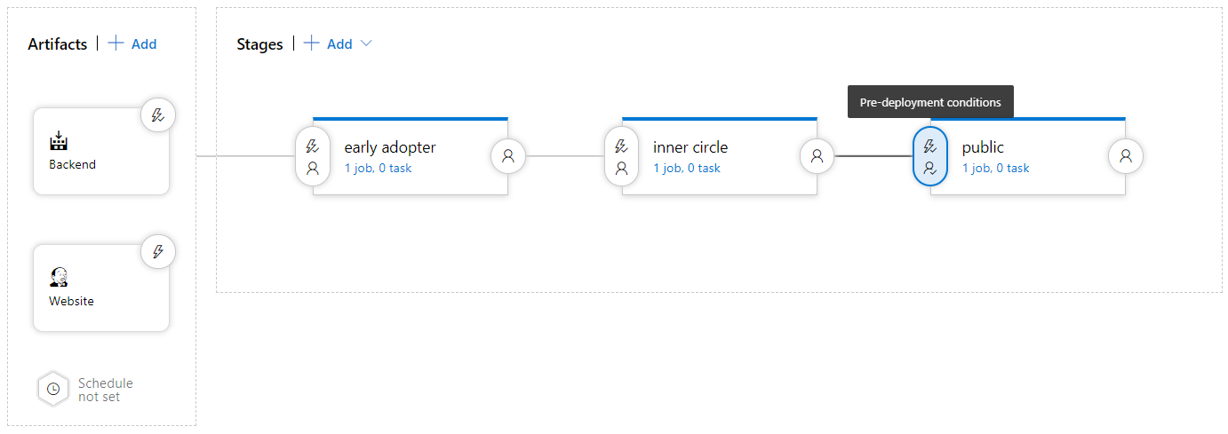
Explore how to measure quality of your release process
Visualize your release process
Symptoms of broken process (every second day, only after rerun, never ending up in last stage)
Dashboard widgets

Slide 64
Examine release notes and documentation
Technical or Functional Documentation?
Where to store Documentation:
Document Store
Wiki
In the code base
In a Work Item

Slide 65
Examine considerations for choosing release management tools
Artifacts and artifact source
Stages
Triggers and schedules
Build and release tasks
Approvals and gates
Traceability, auditability and security

Slide 66

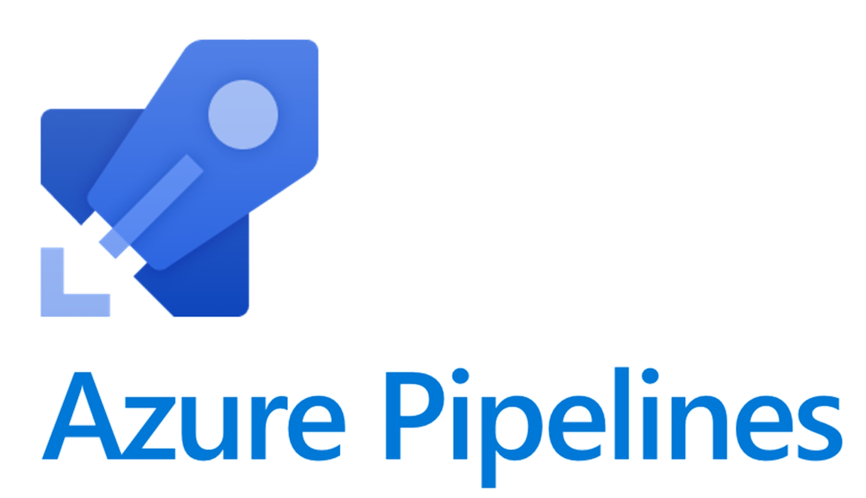
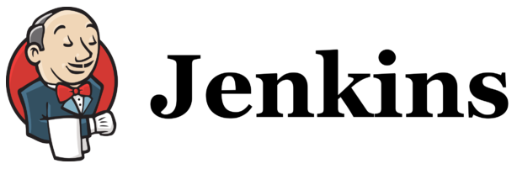

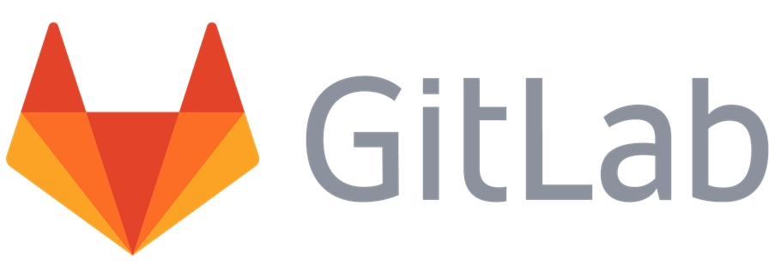

Explore common release management tools
GitHub Actions
GitHub
Azure Pipelines
Jenkins
Circle CI
GitLab Pipelines
Atlassian Bamboo

Slide 67
Labs

Slide 68
Lab: Controlling deployments using Release Gates
Lab overview:
This lab covers the configuration of the deployment gates and details how to use them to control execution of Azure pipelines.
Objectives:
Configure release pipelines
Configure release gates
Test release gates
Duration:
Notes:
The labs are updated on a regular basis. For the latest information please visit:
https://microsoftlearning.github.io/AZ400-DesigningandImplementingMicrosoftDevOpsSolutions/

Slide 69
Lab: Creating a release dashboard
Lab overview:
In this lab, you will step through creation of a release dashboard and the use of REST API to retrieve Azure DevOps release data, which you can make this way available to your custom applications or dashboards.
Objectives:
Create a release dashboard
Use REST API to query release information
Duration:
Notes:
The labs are updated on a regular basis. For the latest information please visit:
https://microsoftlearning.github.io/AZ400-DesigningandImplementingMicrosoftDevOpsSolutions/

Slide 70
Learning Path review and takeaways

Slide 71
What did you learn?
Explain the terminology used in Azure DevOps and other release management tooling
Use release variables and stage variables in your release pipeline
Describe what a build and release task is, what it can do, and some available deployment tasks
Deploy to environment securely using a service connection
Explain why you sometimes need multiple release jobs in one release pipeline
List the different ways to inspect the health of your pipeline and release by using alerts, service hooks, and reports
Differentiate between a release and a deployment
Explain things to consider when designing your release strategy
Define the components of a release pipeline

Slide 72
Learning Path review questions
1
How many deployment jobs can be run concurrently by a single agent?
2
What should you create to store values that you want to make available across multiple build and release pipelines?
3
How can you provision the agents for deployment groups in each of your VMs?
4
How can you identify a default release variable?
5
What can you use to prevent a deployment in Azure DevOps when a security testing tool finds a compliance problem?
6
Even if you create exactly what a user requested at the start of the project, the solution will often be unsuitable for the same user. Why?
Notes:
Q1 Answer: One
Q2 Answer: Variable group
Q3 Answer: One of the following:
Run the script that is generated automatically when a deployment group is created
Install the Azure Pipelines Agent Azure VM extension on each of the VMs
Use the Azure Resource Group Deployment task in your release pipeline
Q4 Answer: It has Release. as its prefix (eg: Release.Reason) Q5 Answer: Release gate
Q6 Answer: Their needs will have changed during the project

